Slide 1

Hazard Communications
Presentation Created by Vanessa Mason
Division of State Parks
Office Phone: 775-684-2797
Email: vanessalmason@parks.nv.gov

Slide 2
What is Hazard Communications?
Known as the “Right to Know Law.”
Worker’s safety can be compromised through the improper handling of chemicals, which can result in injury or death due to fire, explosion or other serious accidents.
Hazard Communication determines the dangers of the chemicals you use on the job and tells you what these hazards are and how to protect yourself from them.

Slide 3
Are All Chemicals Hazardous?
A “Hazardous chemical” is any chemical which is classified as a physical hazard or a health hazard, a simple asphyxiant, combustible dust, pyrophoric gas, or hazard not otherwise classified.
A chemical is considered hazardous to a person and/or the environment whenever an exposure to the chemical can produce a negative response; (e.g., nausea, vomiting, rash, eye or throat irritation.)
Most chemical hazards are minimal, if they are used:
  According to the directions on their label
  According to the SDS
  With the listed appropriate protective equipment

Slide 4
Written Program and SDS Location
Each park has a written Hazard Communication Program. Ask your supervisor to show you where the program is kept.
Each park has at least 1 SDS (Safety Data Sheet) binder.
  An SDS for each chemical currently in use is to be available in the binder.
  All SDS must be kept for a minimum of 30 years.
  Recommend keeping current SDS available and filing “old” SDS in an accessible location.

Slide 5
Where Can You Find Chemicals and How Likely are You to be Exposed to Them?
Chemicals are found everywhere, from ink pens to gasoline.
Most negative exposures to chemicals are rare in the workplace, but that largely hinges on using the chemicals in the appropriate manner and in the proper dilution.
Some positions have a greater tendency to expose employees to chemicals, because of the nature of the work being done.
Two of the most important things you can do to protect yourself from exposure are to know where chemicals are stored and read the SDS for the chemical you are using.

Slide 6
How Can You Tell If There’s Been a Release of Hazardous Chemicals?
Do the chemical containers appear to be compromised (are they degrading, leaking, rusting, etc.)
Is there an unusual smell – can you smell chemicals present?
Are you experiencing a negative reaction– Do you feel lightheaded, dizzy, or nauseous? Are you having difficulty breathing or are you getting a headache?
If you’re experiencing any of those reactions, look at section 4 of the SDS. There is a list of negative symptoms associated with exposure to the chemical and compare that list to any symptoms you’re experiencing. Follow the directions for first aid.

Slide 7
WHAT SHOULD YOU DO IN THE CASE OF CHEMICAL EXPOSURE?
If you feel there has been a chemical spill, leave the area immediately and get to fresh air.
Report the situation to you supervisor
Seek medical attention

Slide 8
HOW CAN THE PARK MINIMIZE OR PREVENT EMPLOYEE EXPOSURE TO CHEMICALS?
Whenever possible, hazardous chemicals should be replaced with less hazardous options.
Employees are to be provided with appropriate PPE when adequate substitute chemicals are not available.
Employees are to be trained on where chemicals are located.
Chemicals are to be stored in appropriate containers and/or cabinets.

Slide 9
Chemical Labels

Slide 10
All Chemicals Must Be
Properly Labeled

Slide 11
Required Label Content
Labels for Hazardous Chemicals must contain:
  The name, address, and telephone number of the manufacturer
  Signal Word
  Hazard Statements
  Precautionary Statement
  Pictograms

Slide 12
Product Identifier
Identifies the hazardous chemical. This can be (but is not limited to):
  chemical name
  code number or batch number
The manufacturer, importer or distributor can decide the appropriate product identifier.
The same product identifier must be both on the label and in section 1 of the SDS

Slide 13
Signal Words
Used to indicate the relative level of severity of the hazard and alert the reader to a potential hazard on the label.
There are only two words used as signal words, “Danger” and “Warning.”
  Within a specific hazard class, “Danger” is used for the more severe hazards and Warning” is used for the less severe hazards.
  There will only be one signal word on the label no matter how many hazards a chemical may have.
  If one of the hazards warrants a “Danger” signal word and another warrants the signal word “Warning,” then only “Danger” should appear on the label.

Slide 14
Hazard Statements
  Describe the nature of the hazard(s) of a chemical, including, where appropriate, the degree of hazard. For example: “Causes damage to kidneys through prolonged or repeated exposure when absorbed through the skin.”
  All the applicable hazard statements must appear on the label.
  Hazard statements may be combined where appropriate to reduce redundancies and improve readability.
  The hazard statements are specific to the hazard classification categories, and chemical users should always see the same statement for the same hazards no matter what the chemical is or who produces it.

Slide 15
Precautionary Statements
Describe recommended measures that should be taken to minimize or prevent adverse effects resulting from exposure to the hazardous chemical or improper storage or handling.
There are four types of precautionary statements:
    Prevention (to minimize exposure)
    Response (in case of accidental spillage or exposure emergency response, and first-aid)
    Storage
    Disposal

Slide 16
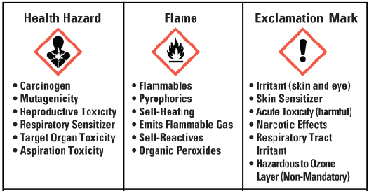
Proper Labeling
The Hazard Communication Standard (HCS) requires pictograms on labels to alert users of the chemical hazards to which they may be exposed. Each pictogram consists of a symbol on a white background framed within a red border and represents a distinct hazard(s). The pictogram on the label is determined by the chemical hazard classification.
Below are just a few of the pictograms that can be found on chemical labels.

Slide 17
Safety Data Sheets (SDS)

Slide 18
All Chemicals Must Have a Safety Data Sheet (SDS)
“Safety data sheet (SDS)” is written or printed material concerning a hazardous chemical that is prepared in accordance with section 5914(g).
The SDS includes information such as:
  the properties of each chemical
  the physical, health, and environmental health hazards
  protective measures
  safety precautions for handling, storing, and transporting the chemical
The information contained in the SDS must be in English (although it may be in other languages as well).

Slide 19
All Chemicals Must Have a Safety Data Sheet (SDS)
Sections 1 through 8 contain general information about the chemical, identification, hazards, composition, safe handling practices, and emergency control measures (e.g., fire fighting). This information should be helpful to those that need to get the information quickly.

Slide 20
All Chemicals Must Have a Safety Data Sheet (SDS)
Section 1, Identification includes:
  product identifier
  manufacturer or distributor name, address, phone number
  emergency phone number
  recommended use
  restrictions on use
Section 2, Hazard(s) identification includes:
  all hazards regarding the chemical
  required label elements

Slide 21
All Chemicals Must Have a Safety Data Sheet (SDS)
Section 3, Composition/information on ingredients:
  includes information on chemical ingredients
  trade secret claims
Section 4, First-aid measures:
  Includes required first aid treatment for exposure to a chemical
  a list of symptoms (immediate or delayed) of exposure

Slide 22
All Chemicals Must Have a Safety Data Sheet (SDS)
Section 5, Fire-fighting measures:
  suitable extinguishing techniques
  equipment
  chemical hazards from fire
Section 6, Accidental release measures:
  lists emergency procedures
  protective equipment
  proper methods of containment and cleanup.

Slide 23
All Chemicals Must Have a Safety Data Sheet (SDS)
Section 7, Handling and storage:
  lists precautions for safe handling and storage, including incompatibilities.
Section 8, Exposure controls/personal protection:
  lists OSHA’s Permissible Exposure Limits (PELs)
  threshold Limit Values (TLVs)
  appropriate engineering controls
  personal protective equipment (PPE)

Slide 24
All Chemicals Must Have a Safety Data Sheet (SDS)
Sections 9 through 11 and 16:
Contain other technical and scientific information such as:
  physical and chemical properties
  stability and reactivity information
  toxicological information (signs of over exposure)
  exposure control information
  other information including the date of preparation or last revision
If the person preparing the SDS does not find any relevant information for any of the required sections, the SDS must say so.

Slide 25
HAZARD RATING SYSTEMS
There are two systems that rate the hazards associated with chemical use. They are:
  NFPA - NATIONAL FIRE PROTECTION ASSOCIATION
  HMIS - HAZARDOUS MATERIAL IDENTIFICATION SYSTEM

Slide 26
NFPA LABEL
The NFPA hazard rating system refers to, in part, a safety standard put forth by the National Fire Prevention Association (NFPA).
This standard, NFPA 704, outlines a hazard rating system for emergency personnel.
FIVE NFPA HAZARD LEVELS
- 4 EXTREME
- 3 HIGH
- 2 MODERATE
- 1 SLIGHT
- 0 INSIGNIFICANT
FIRE HAZARD
4
REACTIVITY
2
1
W
HEALTH HAZARD
SPECIFIC HAZARD
(WATER REACTIVE)

Slide 27
HMIS LABEL
The Hazardous Materials Identification System (HMIS) is a numerical hazard rating that incorporates the use of labels with color developed by the American Coatings Association as a compliance aid for the OSHA Hazard Communication (HazCom) Standard.
FIVE HMIS
HAZARD LEVELS
- 4 SEVERE
- 3 SERIOUS
- 2 MODERATE
- 1 SLIGHT
- 0 MINIMAL

Slide 28
Personal Protective Equipment

Slide 29
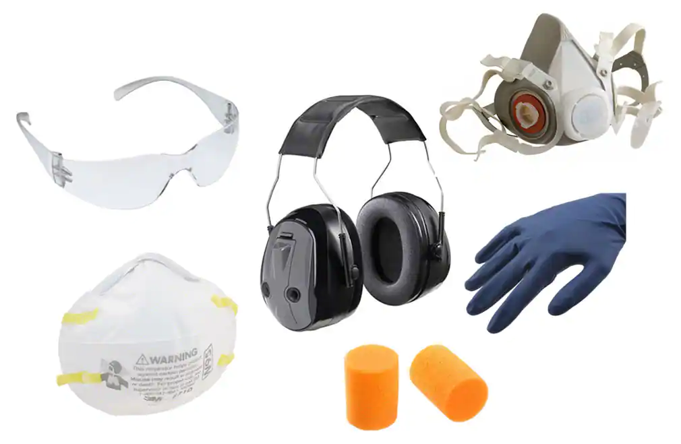
Personal Protective Equipment (PPE)
Hazardous Chemicals can be inhaled, ingested, or absorbed through the skin.
When using Hazardous Chemicals, you are required to use the appropriate PPE as prescribed on the label and the SDS
Make sure the PPE fits and is not torn or broken

Slide 30
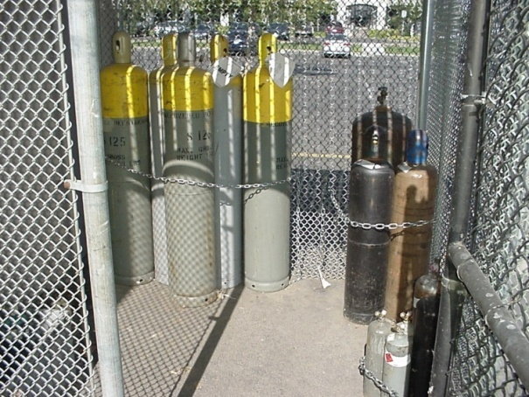

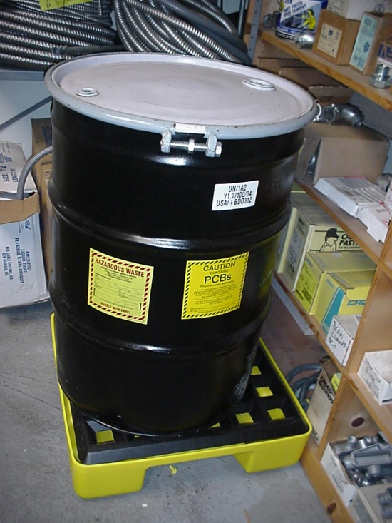
ALL HAZARDOUS CHEMICALS MUST BE PROPERLY STORED
All Hazardous Chemicals must be properly stored according to the Hazard Communication Program

Slide 31
HAZARDOUS MATERIALS CONTAINER REQUIREMENTS
Containers Must Be:
Properly labeled
Inspected weekly for leaks, spills and deterioration
Suitable for storing the waste and compatible with the contents
Empty containers >5 gallons which previously held a hazardous material or waste must be labeled “empty” with the date they were emptied and recycled, reused or returned to the vendor within 1 year

Slide 32
CONTAINERS CONT.
In good condition
Kept closed when not in use
Located 50 feet from the property line if holding ignitable or reactive wastes
Grounded if holding flammable waste
Reactive wastes must be stored separately or be separated by a dike, berm, wall or other barrier

Slide 33
HAZARDOUS MATERIALS STORAGE
INFORMATION
Storage:
Only chemicals that are used are stored (chemicals not needed are to be disposed of).
Chemicals on hand will be consumed essentially within the next year.
Chemicals are properly labeled and stored in appropriate containers.
SDS is on file for each chemical received and made accessible for review.
There is a continual up-to-date inventory of all chemicals.

Slide 34
STORAGE CONT.
No chemicals are stored above eye level.
No chemicals are stored on the floor.
Shelves or cabinets are secured firmly to the walls.
Earthquake lips or barriers are in place on storage shelves.
A storage cabinet for flammables is on site and is appropriately used
Compressed gas cylinders are secured upright to the wall, with caps in place.

Slide 35
PROCEDURES FOR CHEMICAL SPILL & MATERIAL RELEASE
If a large amount of chemical has been spilled (more than what you can safely clean up) leave the area and call 9-1-1.
Resist the urge to rush in:
  others cannot be helped until the situation has been fully assessed
Assess the situation:
  What actions should be taken
  Is an evacuation necessary
  What can be done immediately
  Understand the potential hazards

Slide 36
EMERGENCY PROCEDURES CONTINUED
Secure the scene:
  Without entering the immediate hazard area, isolate the area
  Assure the safety of people and the environment
  Keep people away from the scene and outside the safety perimeter
NOTIFY SUPERVISOR

Slide 37
PROCEDURES FOR CHEMICAL SPILL & MATERIAL RELEASE
Be prepared to administer First Aid
Have supplies ready and available in case of a small spill or leak. Appropriate materials may be:
  Absorbent
  5-gallon container, with lid
  Broom and dustpan
  PPE

Slide 38
First Aid

Slide 39
Chemical Exposure
Chemicals can expose us to hazards in various ways. Chemicals can enter the body by:
  Inhalation – gases and airborne particulate can be breathed in through your nose or mouth.
  Absorption – chemicals, including dust, smoke or vapors can enter your body through your skin or eyes.
  Ingestion – chemicals can enter your body through your mouth.
  Injection – may occur through the misuse of syringe needles, accidents with broken glass or other sharp objects contaminated with chemicals, or through high pressure streams of liquids or gases. Injection is not a common route of entry.

Slide 40
First Aid for Chemical Exposure
Stop the source
  remove the person from contact with the chemical spill, airborne particles, or fumes. Wear gloves or use other safety equipment as needed to protect yourself from exposure to the chemical.
  Take off any clothes or jewelry that have been in contact with the chemical. Chemical injuries, just like heat burns, get worse as long as the source is in contact with the body.
Clear the lungs
  Get the person to fresh air.
  Be prepared to administer CPR if the person appears to be unconscious

Slide 41
First Aid for Chemical Exposure (continued)
Flush the eyes
  Flush the affected eye with water for at least 15 minutes.
  Make sure the water is cool, especially if its source is an outside eyewash station.
  Don’t accidentally flush chemicals into an unaffected eye
    Hold the head so that the injured eye is on the bottom.
    Flush from the nose downward.

Slide 42
First Aid for Chemical Exposure (continued)
Clean the skin
  Brush water-activated chemicals from the skin. Be careful not to brush particles into the eyes.
  If the chemical does not react with water, flush the affected skin with cool water for at least 15 minutes.
  Make sure the water flow is not forceful enough to cause pain or break blisters.
  Do not brush away chemicals with your bare hands.

Slide 43
Eyewash Stations
Eyewash stations are to be activated once a week
Self-contained emergency eyewash and shower stations are required to be inspected weekly.
  Inspections must be documented (a simple checklist with employee name and date of inspection is sufficient).
Eyewash flushing fluid must be a tepid temperature (60 to 100 degrees Fahrenheit) to promote at least 15 minutes of continuous irrigation.
Employers must train employees on knowing where to locate the nearest emergency eyewash in their work area and ensure employees understand how to use the station.
Emergency eyewash equipment should be available for immediate use, and in no instance should it take an individual longer than 10 seconds to reach the equipment and utilize the flushing fluid. A distance of no greater than 55 feet meets the 10 second requirement.

Slide 44
When to seek medical assistance
Chemicals may cause serious damage not only to the outside of the body, but also to the inside. If absorbed into the blood, chemicals may start a silent attack on the kidneys or liver.
Seek medical attention right away if any of the following is true:
  A chemical has come into contact with the eyes, nose, or mouth.
  The Safety Data Sheet calls the chemical hazardous or likely to cause damage.
  The container label warns of corrosive contents, which can wear away skin.

Slide 45
Call 9-1-1 if . . . . .
Call 9-1-1 right away if the victim has:
  Symptoms of shock
  Trouble breathing
  Burns over a large area of the body
While you wait for emergency services to arrive:
  Reassure the person.
  Be prepared to administer CPR if the person does not appear to be breathing.

Slide 46
IN CONCLUSION
This presentation has a lot of information to absorb and process.
Please take the time to become familiar with the chemicals the site uses and read through the SDS associated with that chemical.
Always err on the side of caution. If you feel there is something hazardous with the chemical you’ve been given, please do not use it until you’ve addressed your question with your supervisor.
Your safety is priority #1. If you have ANY questions, please do not hesitate to ask.

